Slide 1


IMAGE PROCESSING WITH SIFT
Assignment 5
Nicola Gugole
ID: 619625

Slide 2
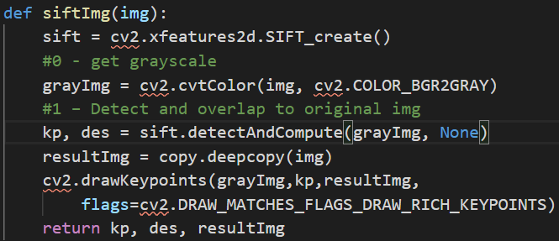
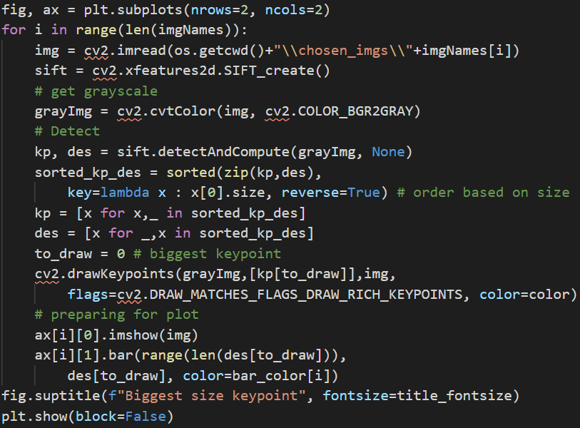
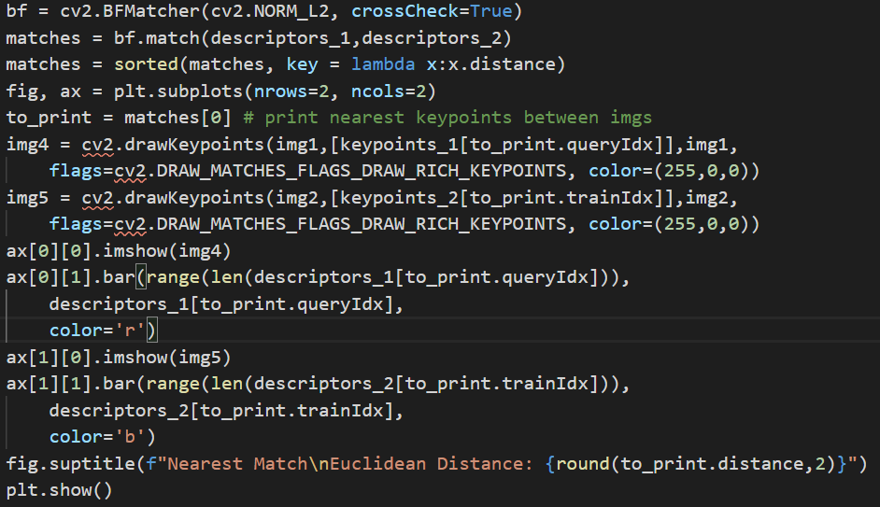
Basic Keypoint Detection, Description
Fun Fact: Keypoint object has size field, but also response (strength), angle of orientation and pt for coordinates access
Drawing Keypoints with Correct Sizes
Biggest Keypoint Selection and Drawing for Visual Comparison
Finding Matching Keypoints and ordering by Euclidean Distance
Drawing Nearest Match and Print Distance

Slide 3
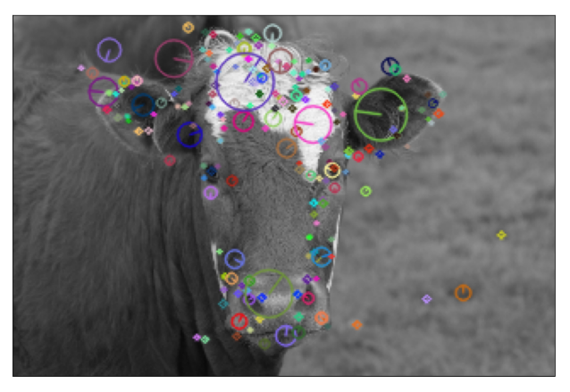
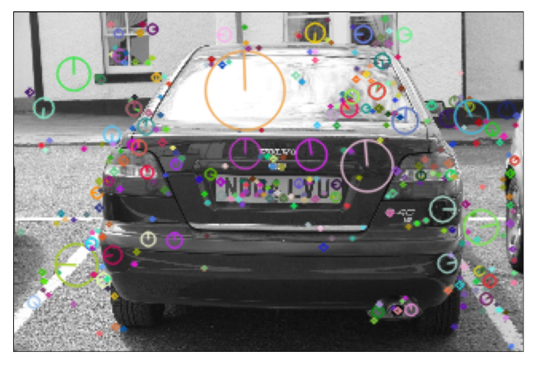
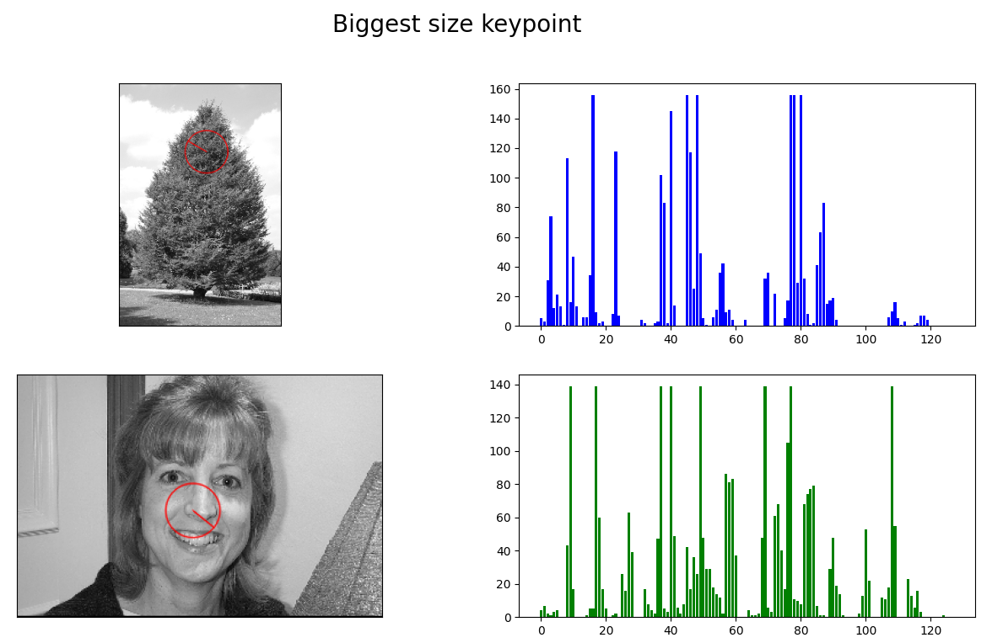
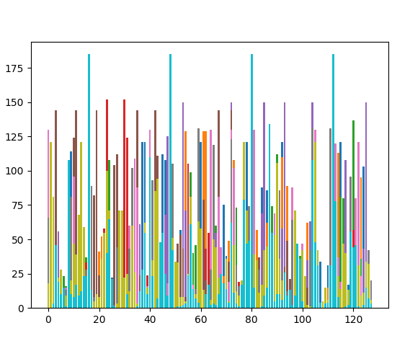
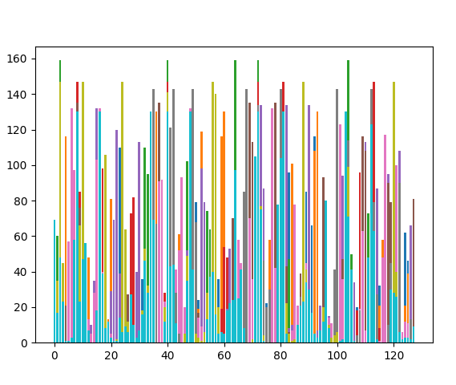
Keypoint Overlapping and Biggest KP Comparison

Slide 4
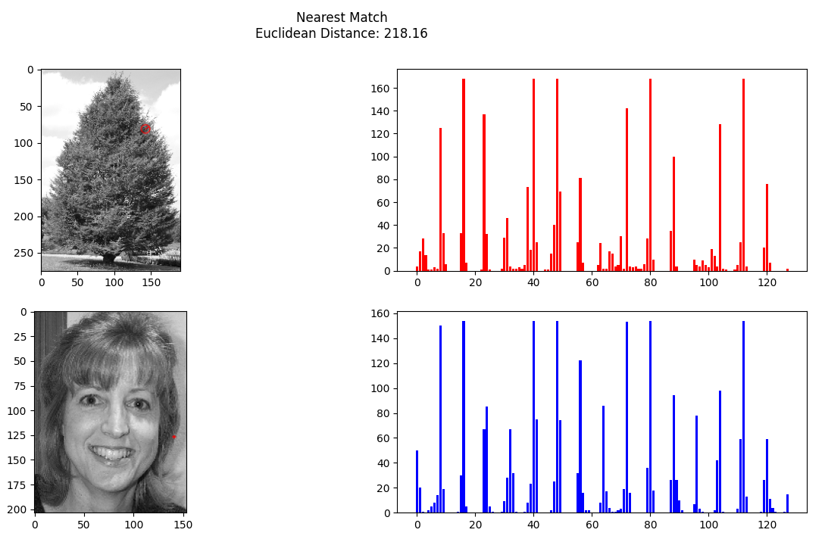
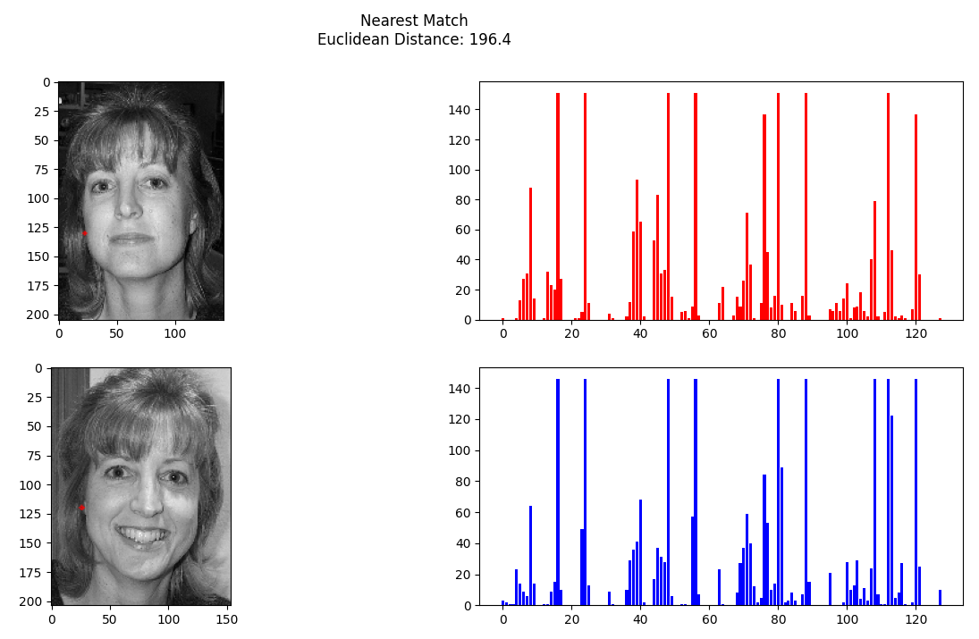
Matching Nearest Descriptors
Extremely different images may have incredibly similar descriptors..
Nearest descriptors in similar images make much more sense.
Single descriptors are NOT enough descriptive for the image, the set of descriptors are what makes the method work!

Slide 5
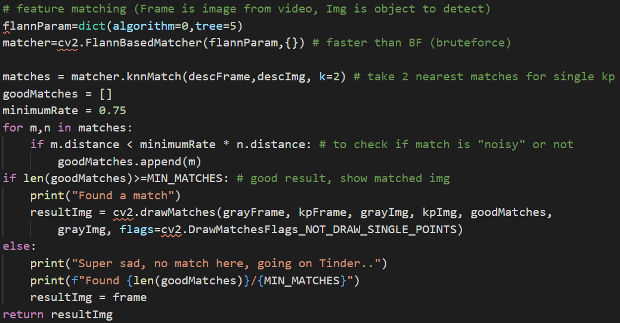
An application: Object Recognition
Key Aspect
Take first and second nearest match for each keypoint, if distance of first one is not much smaller than second one:
BAD MATCH (not a good descriptor)
Find enough GOOD MATCHES and you have recognized the object
Quick Hints :
Crop the image
Use images with lot of details!

Slide 6
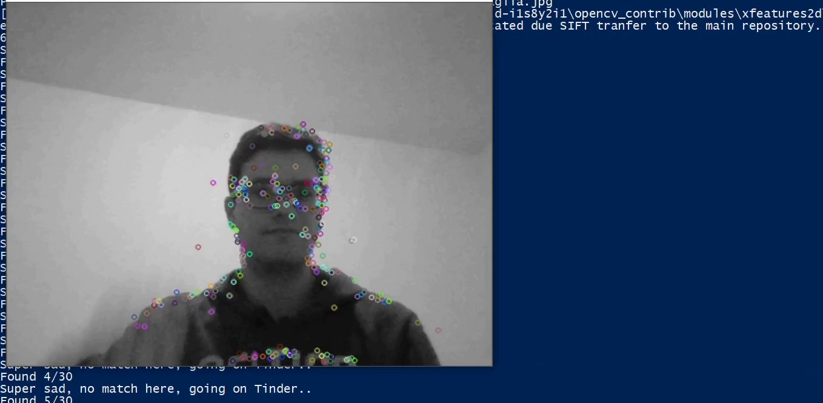
Object Recognition in Practice

Slide 7
Thank you for the attention (for code curiosities, here)

